Slide 1
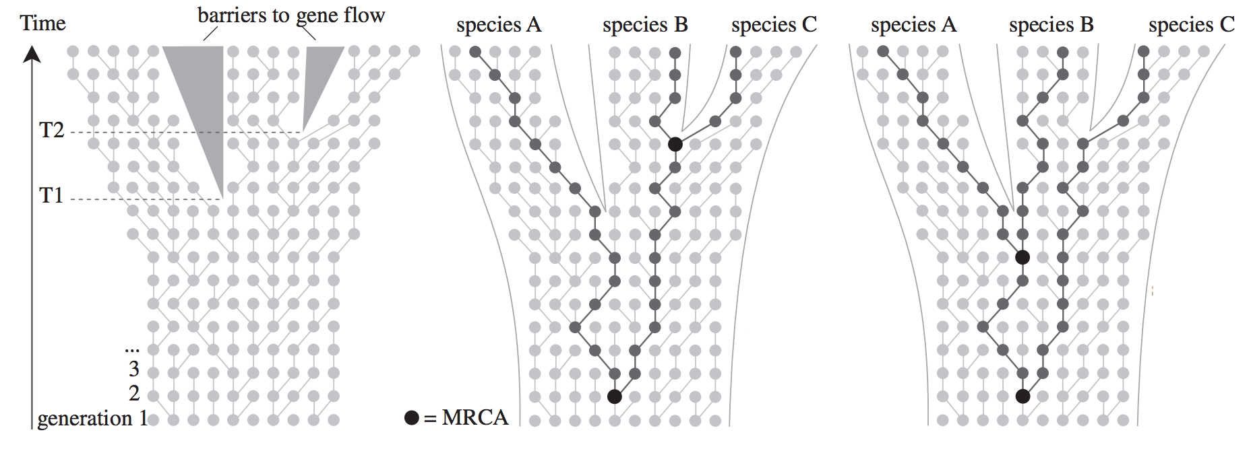
Lab 8: Coalescent Theory
BIOL4174/5174 Conservation Genetics
Image: Leilart et al (2014) J. Phycology. Stolen from Wil Freyman’s slides

Slide 2
“The Coalescent”
Described as the “n-coalescent” by John Kingman (1982)
Provides a way to generate a theoretical distribution of genealogies to compare with observed data to infer demographic history of a population
Requires an assumed simplistic model of population demographics

Slide 3
The Wright-Fisher Model (1930)
Discrete, non-overlapping generations
Fixed and finite population size (N_{e})
Random mating
No selection
No population structure
Full neutrality
Predicts all change due to genetic drift

Slide 4
Forward-time Wright-Fisher model
Time

Slide 5
Forward-time Wright-Fisher model
Time

Slide 6
Forward-time Wright-Fisher model
Time

Slide 7
Forward-time Wright-Fisher model
Time

Slide 8
Forward-time Wright-Fisher model
Time

Slide 9
Coalescent Theory: Looking at same process backwards in time
Time

Slide 10
Coalescent Theory: Looking at same process backwards in time
MRCA of all extant lineages
Time

Slide 11
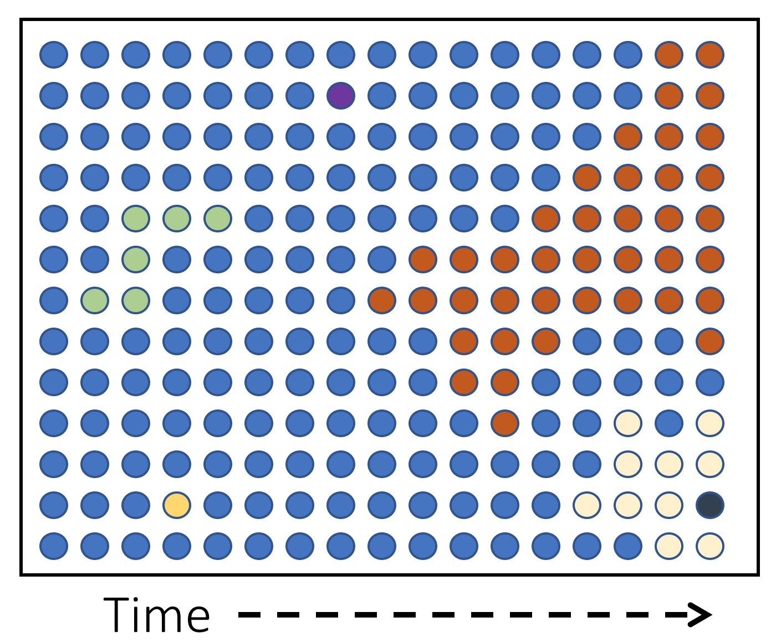
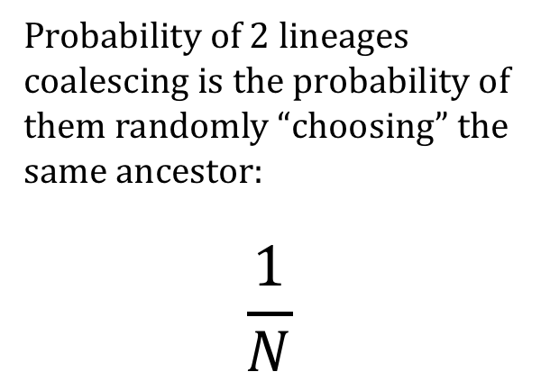
Coalescent probabilities
Probability of 2 lineages coalescing is the probability of them randomly “choosing” the same ancestor:
$$\frac{1}{N}$$
Note: Probability of coalescence for alleles in a diploid population would be 1/2N

Slide 12
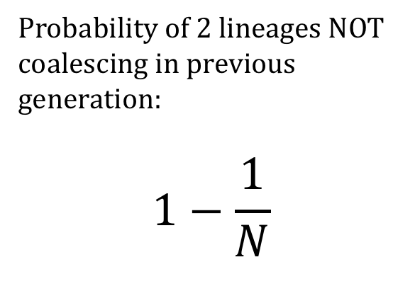
Coalescent probabilities
Probability of 2 lineages NOT coalescing in previous generation:
$$1−\frac{1}{N}$$

Slide 13
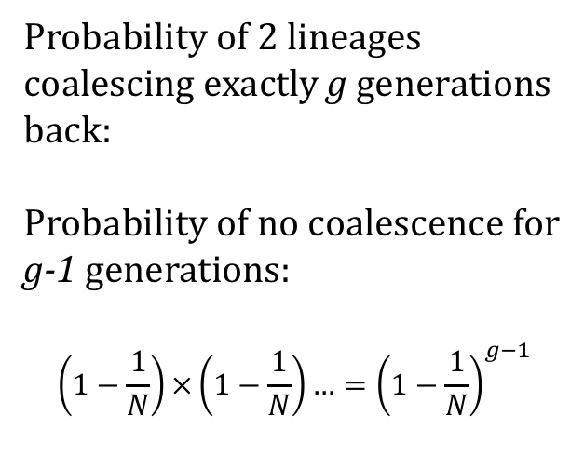
Coalescent probabilities
g
Probability of 2 lineages coalescing exactly g generations back:
Probability of no coalescence for g-1 generations:
$$\left(1−\frac{1}{N}\right)×\left(1−\frac{1}{N}\right)…={\left(1−\frac{1}{N}\right)}^{g−1}$$

Slide 14
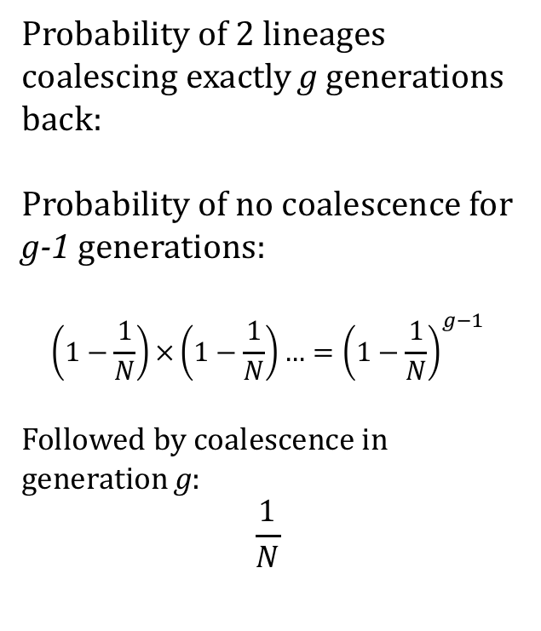
Coalescent probabilities
g
Probability of 2 lineages coalescing exactly g generations back:
Probability of no coalescence for g-1 generations:
$$\left(1−\frac{1}{N}\right)×\left(1−\frac{1}{N}\right)…={\left(1−\frac{1}{N}\right)}^{g−1}$$
Followed by coalescence in generation g:
$$\frac{1}{N}$$

Slide 15
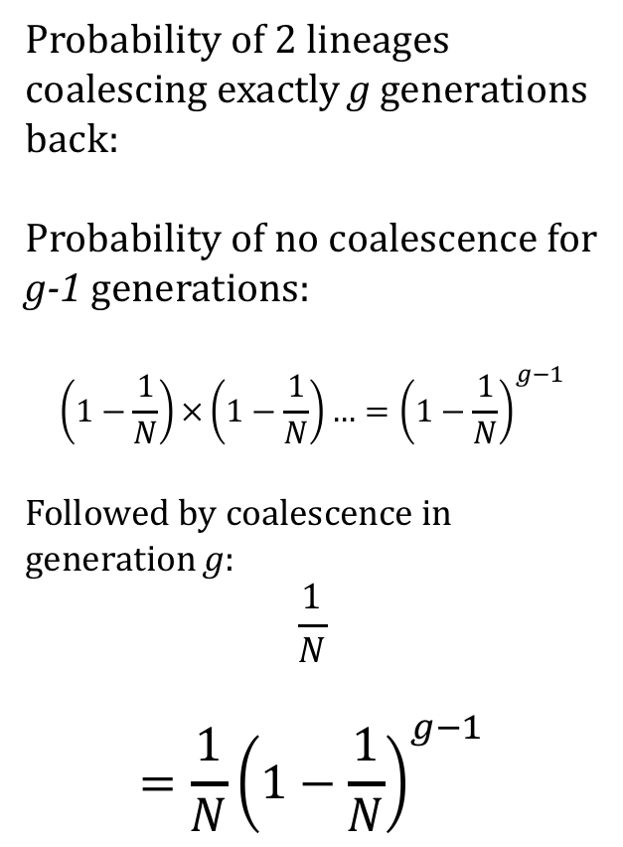
Coalescent probabilities
g
Probability of 2 lineages coalescing exactly g generations back:
Probability of no coalescence for g-1 generations:
$$\left(1−\frac{1}{N}\right)×\left(1−\frac{1}{N}\right)…={\left(1−\frac{1}{N}\right)}^{g−1}$$
Followed by coalescence in generation g:
$$\frac{1}{N}$$
$$={\frac{1}{N}\left(1−\frac{1}{N}\right)}^{g−1}$$

Slide 16
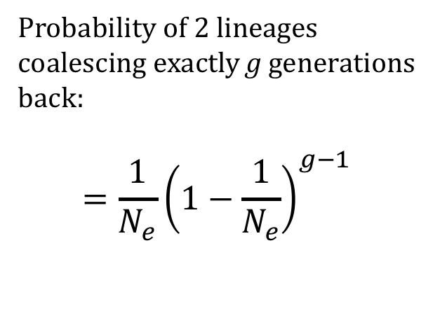
Coalescent probabilities
g
Probability of 2 lineages coalescing exactly g generations back:
$$={\frac{1}{N_{e}}\left(1−\frac{1}{N_{e}}\right)}^{g−1}$$
(This is a geometric distribution)

Slide 17
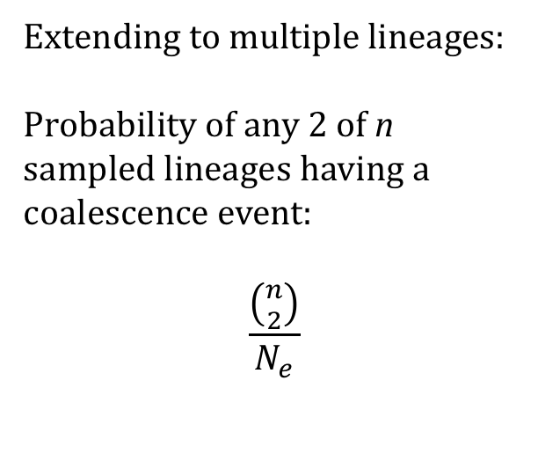
Coalescent probabilities
g
Extending to multiple lineages:
Probability of any 2 of n sampled lineages having a coalescence event:
$$\frac{\left({n \atop 2}\right)}{N_{e}}$$

Slide 18
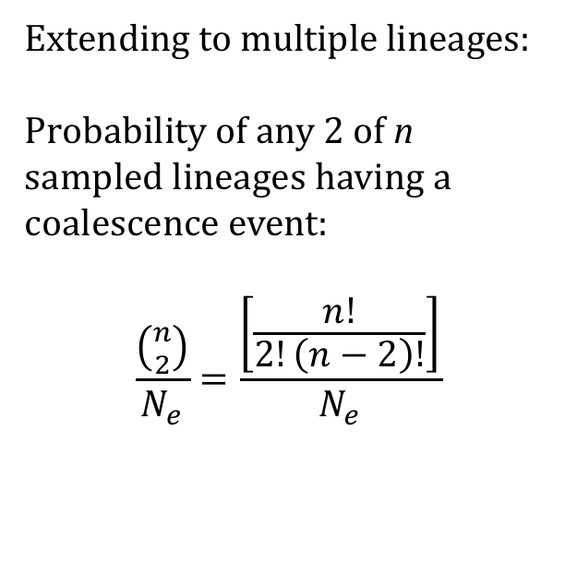
Coalescent probabilities
g
Extending to multiple lineages:
Probability of any 2 of n sampled lineages having a coalescence event:
$$\frac{\left({n \atop 2}\right)}{N_{e}}=\frac{\left[\frac{n!}{2!\left(n−2\right)!}\right]}{N_{e}}$$

Slide 19
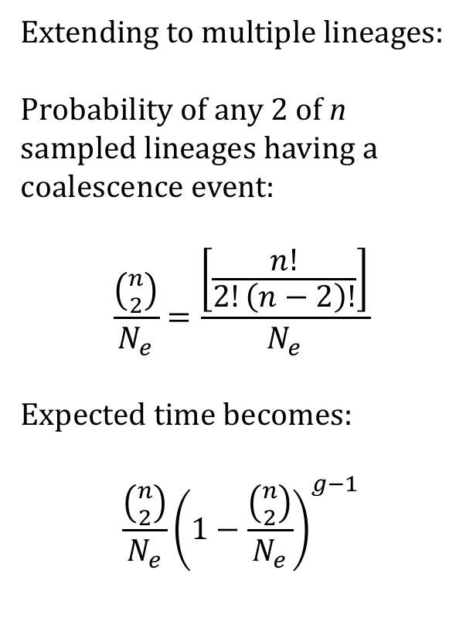
Coalescent probabilities
g
Extending to multiple lineages:
Probability of any 2 of n sampled lineages having a coalescence event:
$$\frac{\left({n \atop 2}\right)}{N_{e}}=\frac{\left[\frac{n!}{2!\left(n−2\right)!}\right]}{N_{e}}$$
Expected time becomes:
$${\frac{\left({n \atop 2}\right)}{N_{e}}\left(1−\frac{\left({n \atop 2}\right)}{N_{e}}\right)}^{g−1}$$

Slide 20
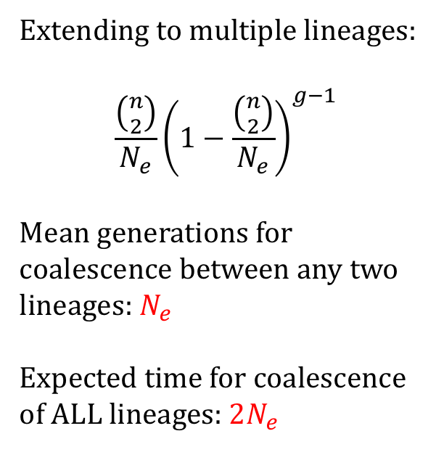
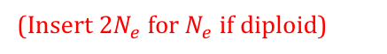
Coalescent probabilities
g
Extending to multiple lineages:
$${\frac{\left({n \atop 2}\right)}{N_{e}}\left(1−\frac{\left({n \atop 2}\right)}{N_{e}}\right)}^{g−1}$$
Mean generations for coalescence between any two lineages: $N_{e}$
Expected time for coalescence of ALL lineages: ${2N}_{e}$
(Insert $2N_{e}$ for $N_{e}$ if diploid)

Slide 21
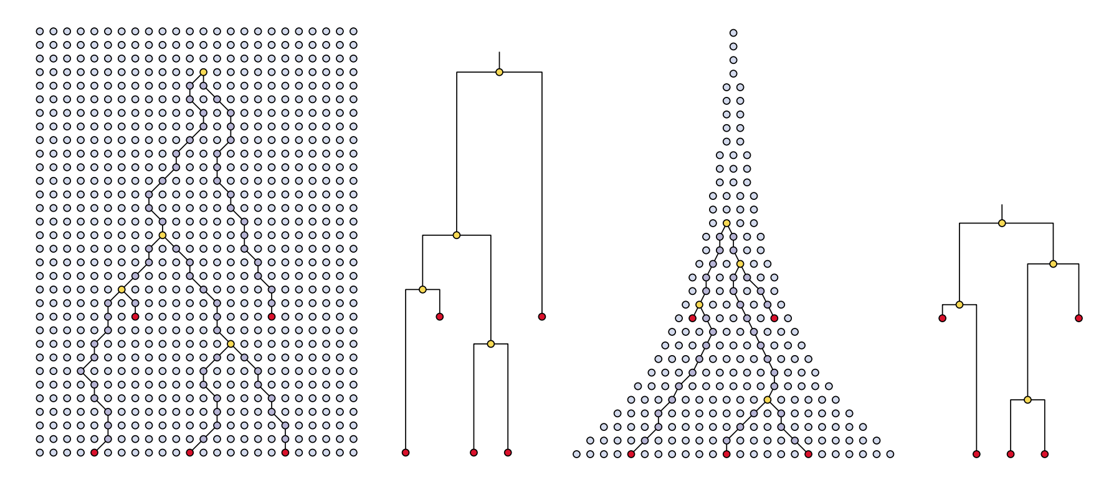
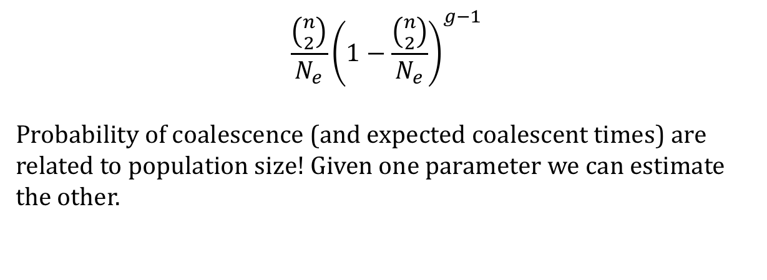
Why do we care???
$${\frac{\left({n \atop 2}\right)}{N_{e}}\left(1−\frac{\left({n \atop 2}\right)}{N_{e}}\right)}^{g−1}$$
Probability of coalescence (and expected coalescent times) are related to population size! Given one parameter we can estimate the other.
Image: Drummond et al (2003). TREE

Slide 22
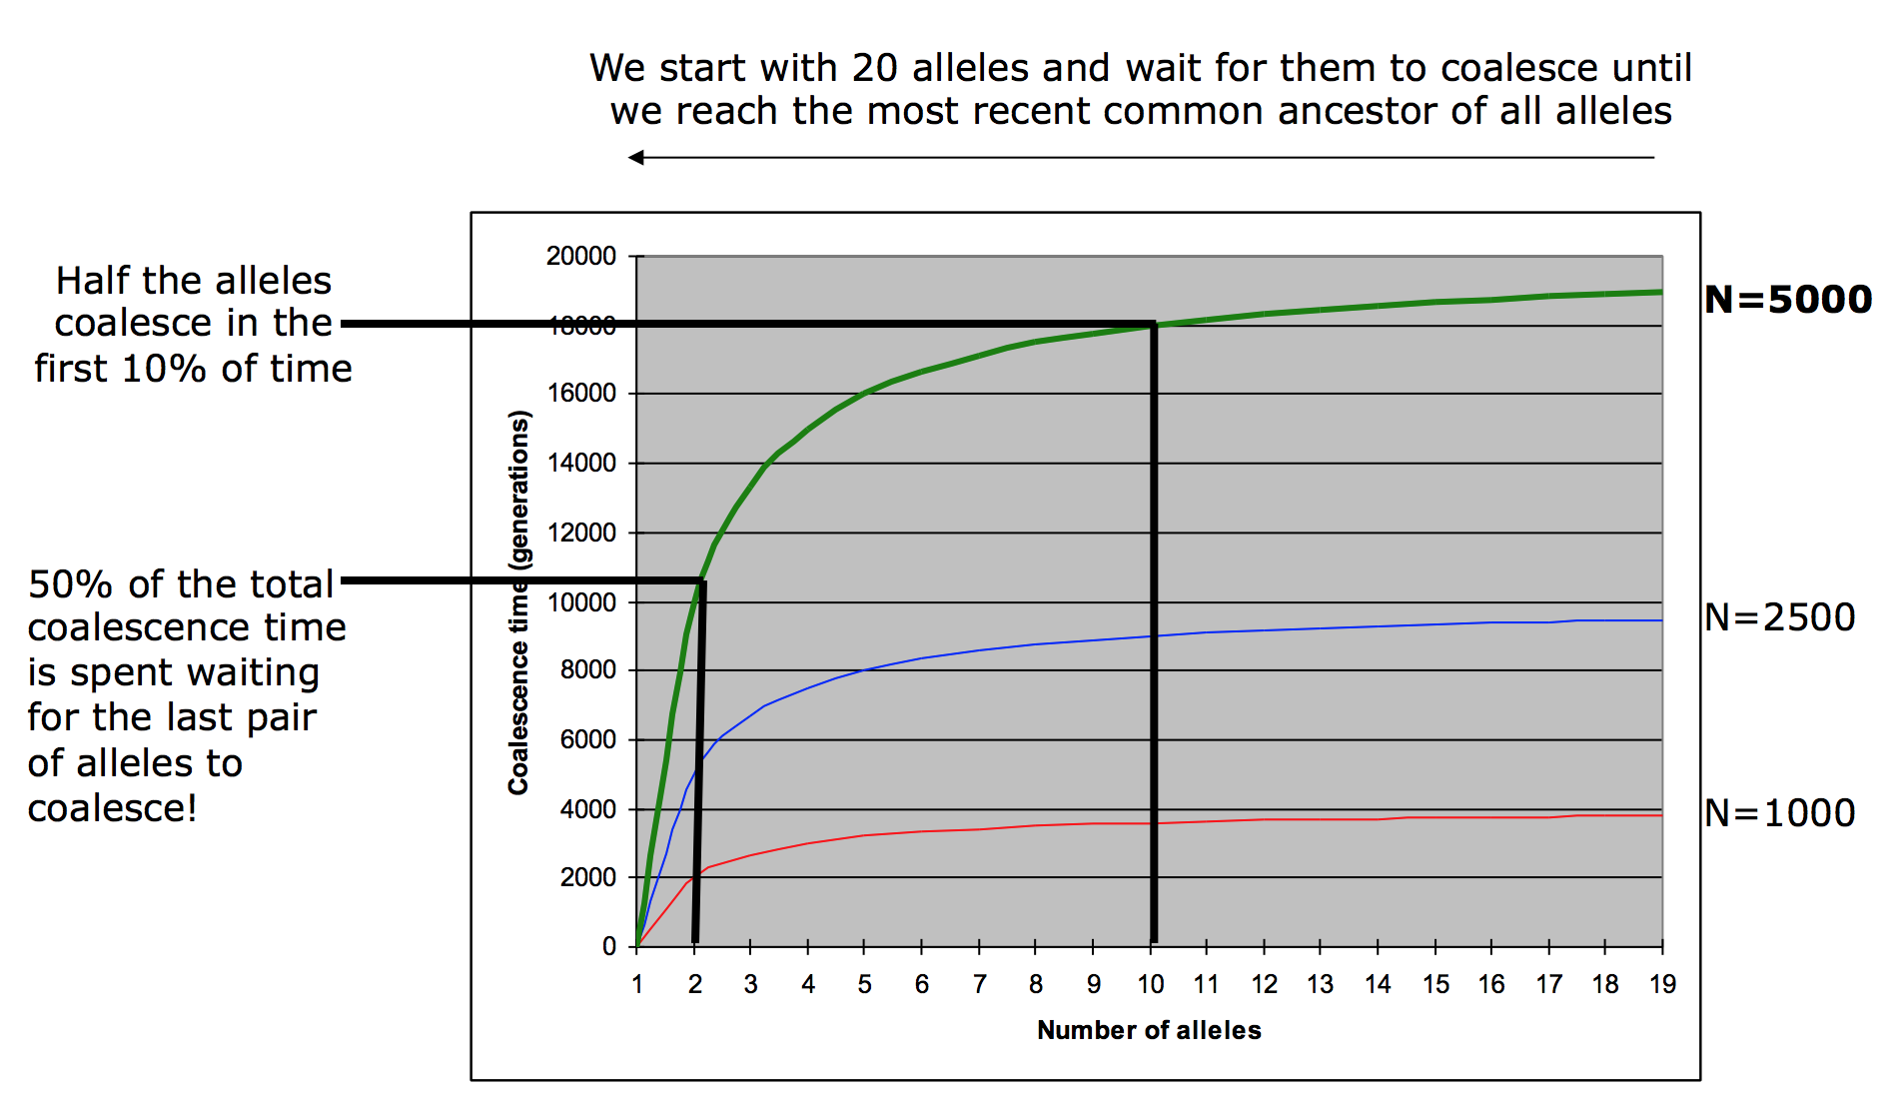
Properties of the coalescent
Stolen from Mick Elliot and Arne Mooers’ slides

Slide 23
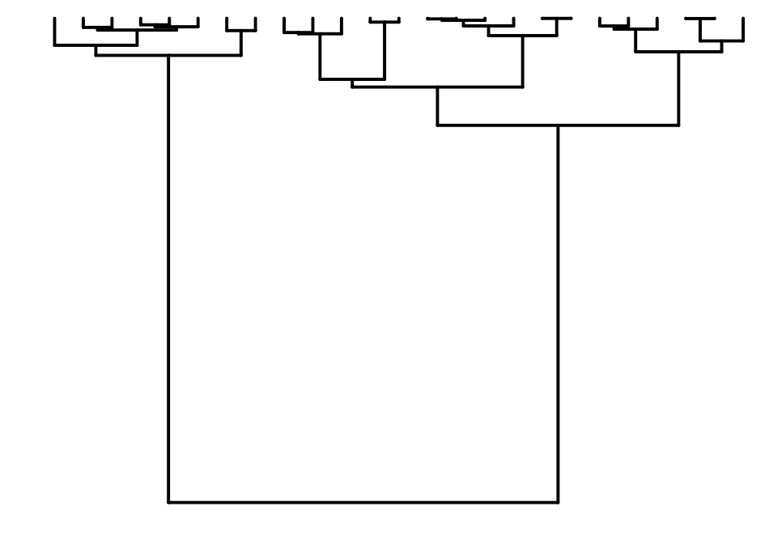
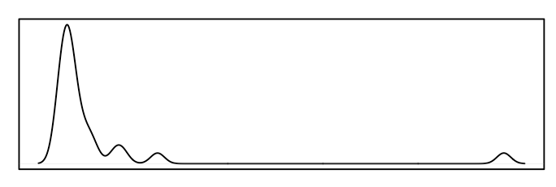
Properties of the coalescent
Coalescent trees are top-heavy, with most coalescence happening very quickly…
Coalescence
Time
Simulations done with coala in R, plots with ape

Slide 24
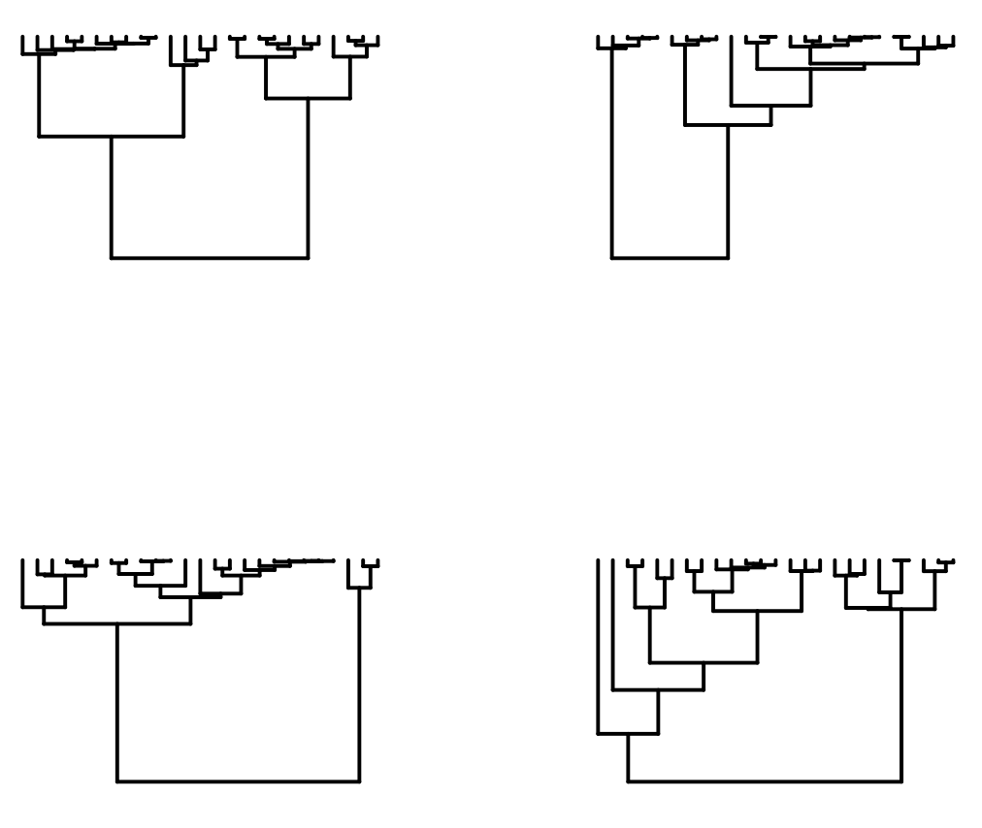
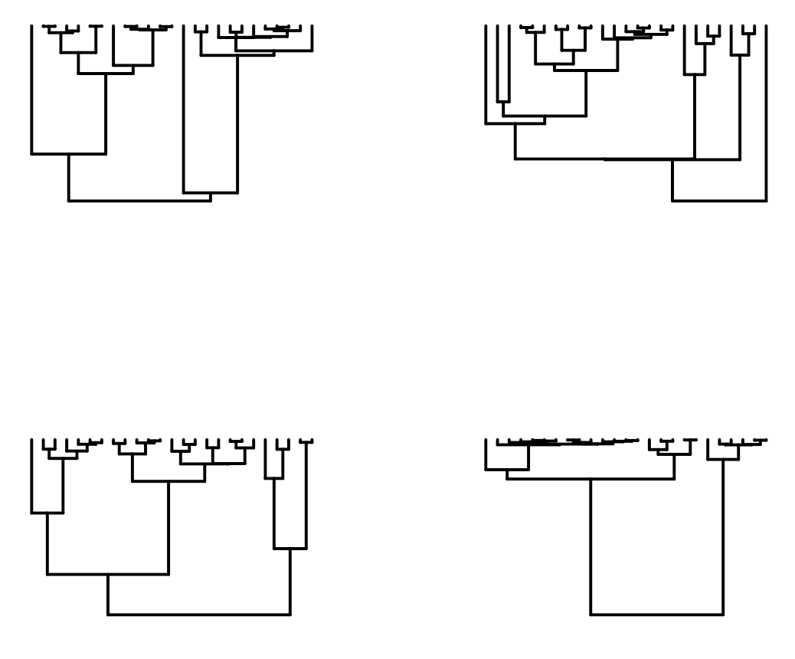
Properties of the coalescent
Exponential nature of time between coalescent events makes the coalescent distribution very noisy… Here are some trees simulated under identical conditions:
Simulations done with coala in R, plots with ape

Slide 25
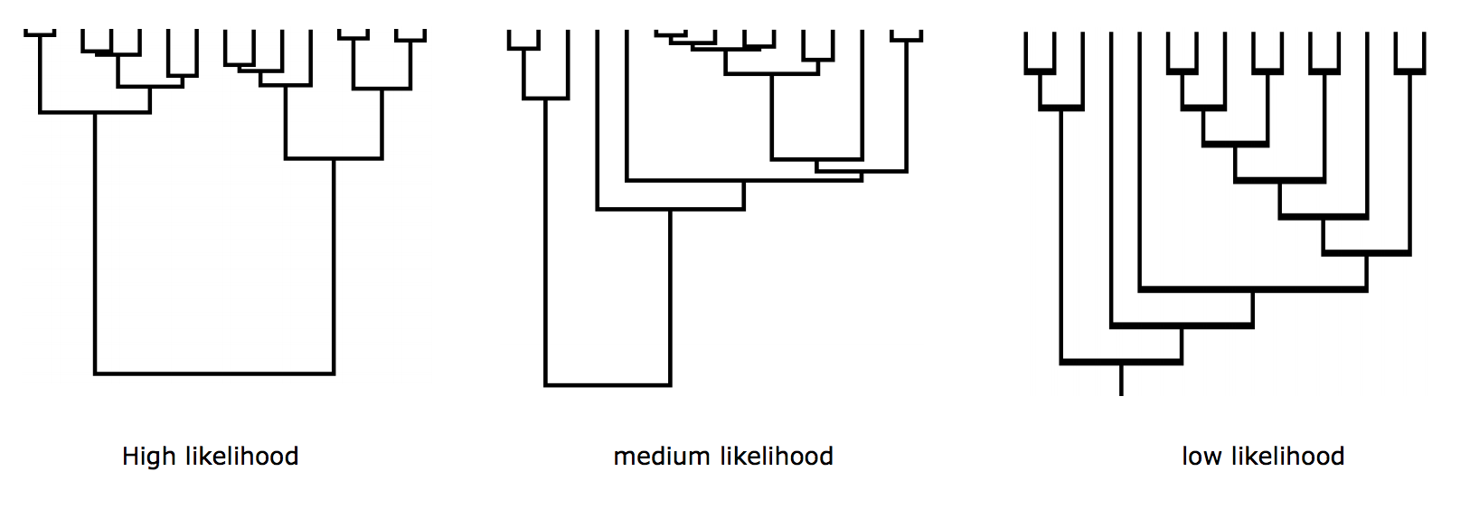
Properties of the coalescent
The coalescent can be used to simulate large numbers of possible genealogies. Some genealogies are more likely than others.

Slide 26
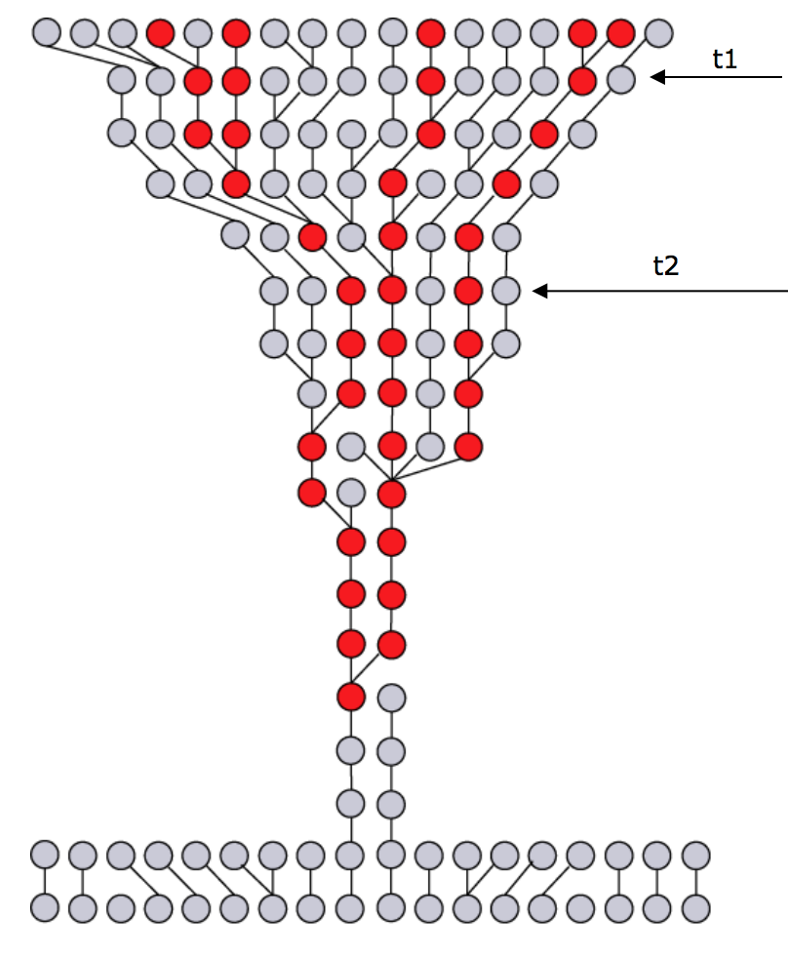
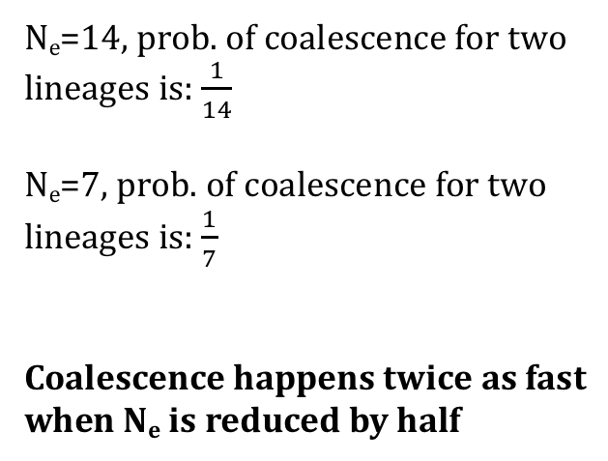
Uses of coalescent theory: Ancestral population sizes
The Wright-Fisher assumption of fixed N_{e} likely is inaccurate…
Ancestral population size changes effect the expected rate of coalescence:
N_{e}=14, prob. of coalescence for two lineages is: $\frac{1}{14}$
N_{e}=7, prob. of coalescence for two lineages is: $\frac{1}{7}$
Coalescence happens twice as fast when N_{e} is reduced by half
Time

Slide 27
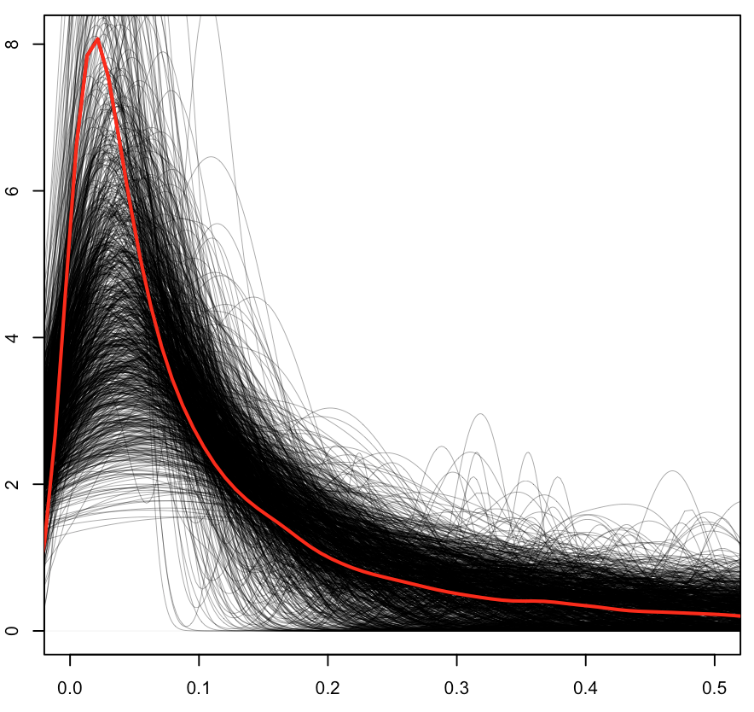
Uses of coalescent theory: Ancestral population sizes
We can use departure from expected coalescent distribution to infer demographic change!
Stable population size over time
As expected, most coalescence happens very quickly, although there is a lot of variation among genes.
Coalescent Units

Slide 28
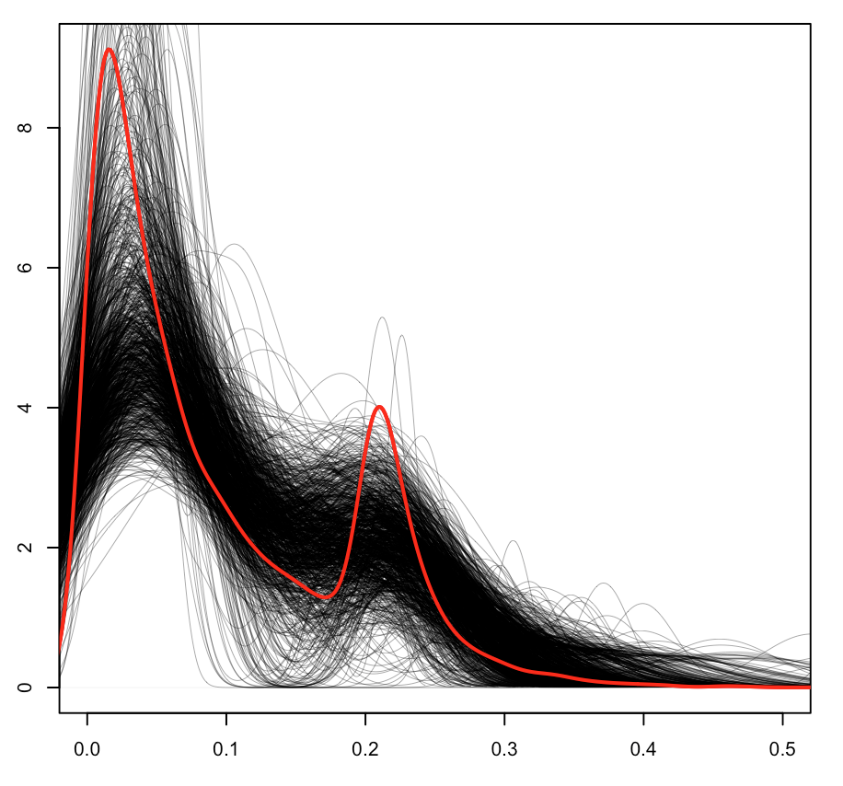
Uses of coalescent theory: Ancestral population sizes
Decreases in effective population size (e.g. a bottleneck) cause increased rate of coalescence
Stable population size over time
Bottleneck to 10% N_{e} at time t=0.3
Coalescent Units
Coalescent Units

Slide 29
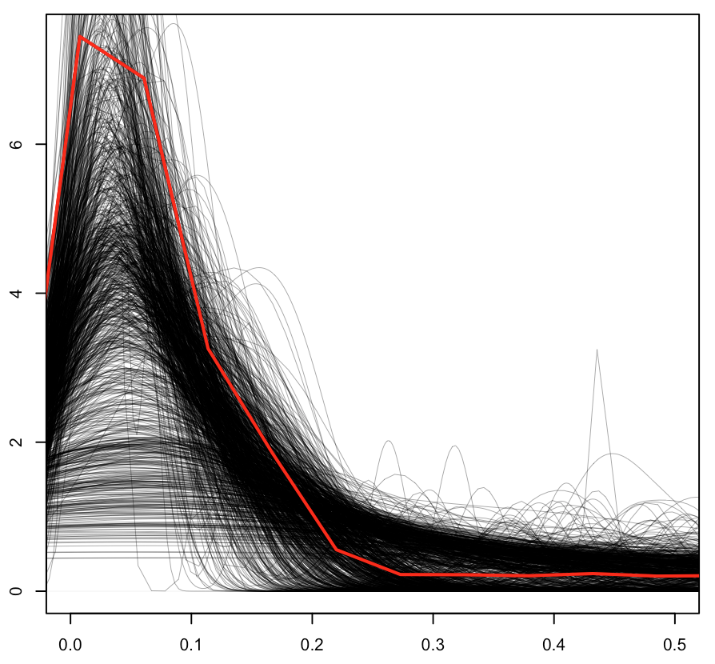
Uses of coalescent theory: Ancestral population sizes
Increases in effective population size (expansion) cause decreased rate of coalescence
Stable population size over time
Growth to 500% N_{e} at time t=0.3
Coalescent Units
Coalescent Units

Slide 30
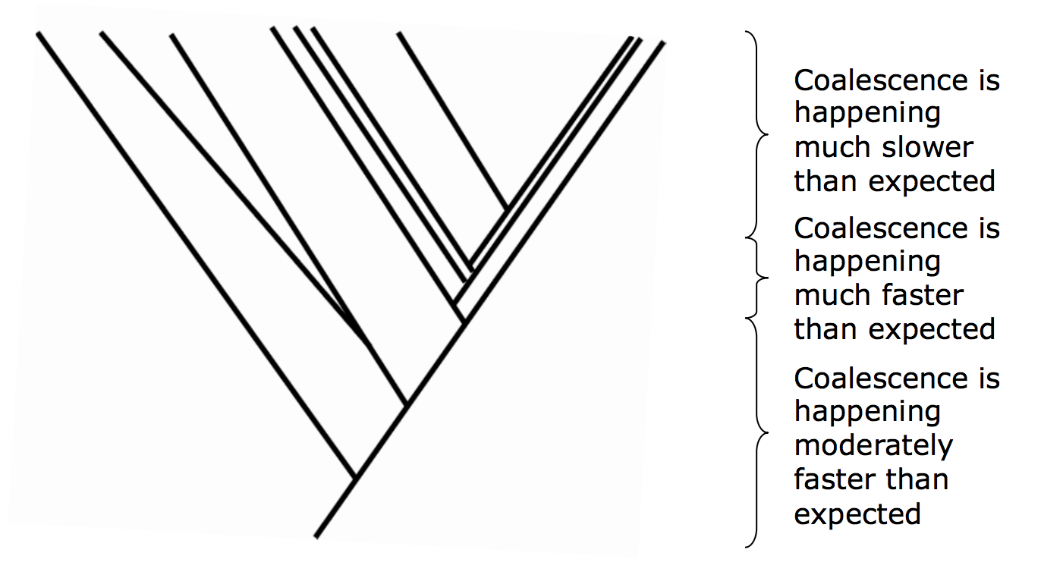
Uses of coalescent theory: Ancestral population sizes
We can extend this idea to observed genealogies to infer N_{e} change through time
↑↑N_{e}
↓↓N_{e}
↑N_{e}
Image: Mick Elliot’s slides

Slide 31
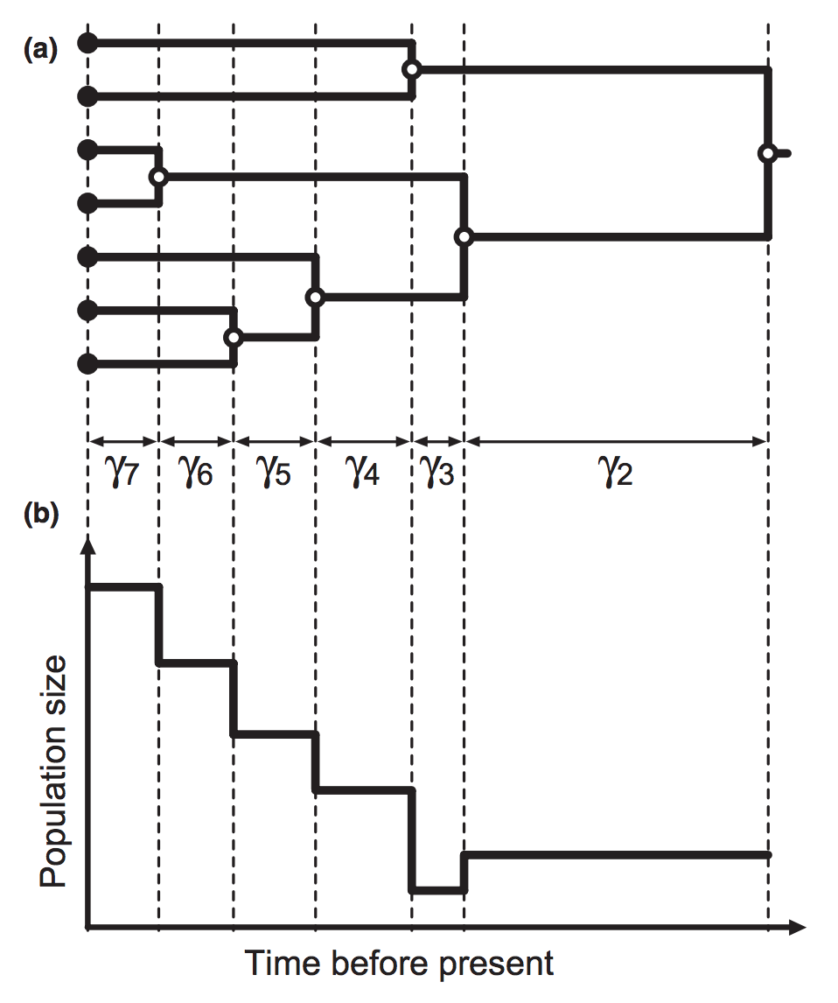
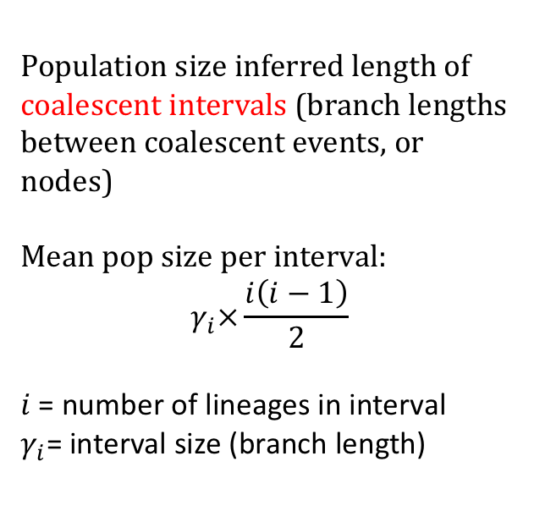
Uses of coalescent theory: Ancestral population sizes
We can extend this idea to observed genealogies to infer N_{e} change through time
Population size inferred length of coalescent intervals (branch lengths between coalescent events, or nodes)
Mean pop size per interval:
$$γ_{i}×\frac{i\left(i−1\right)}{2}$$
$i$= number of lineages in interval
$γ_{i}$= interval size (branch length)
Image: Ho and Shapiro (2011), Molecular Ecology

Slide 32
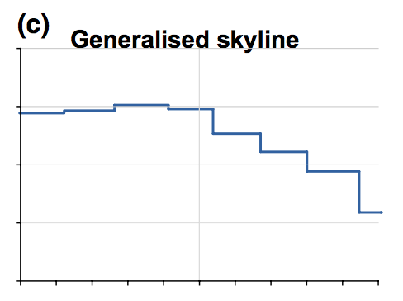
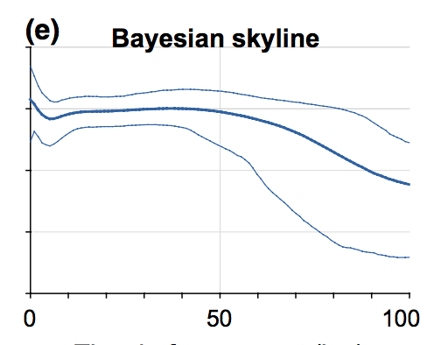
Uses of coalescent theory: Ancestral population sizes
BEAST (what we will use) takes a Bayesian approach:
MCMC sampling co-estimates genealogy, parameters of substitution model, and demographic model
Still considers changes at certain intervals, but takes into account error (e.g. in inference of genealogical model)
Image: Ho and Shapiro (2011), Molecular Ecology

Slide 33
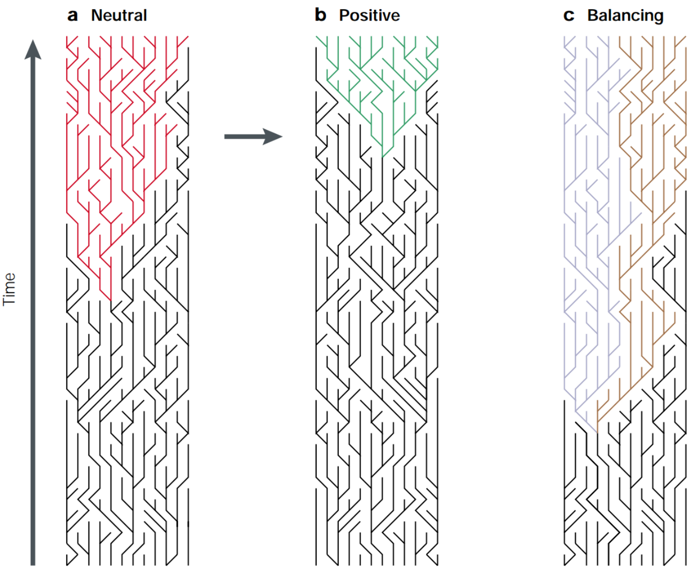
Uses of coalescent theory: Selection
We can also explore deviations at other assumptions of the Wright-Fisher model
Bamshad and Wooding (2003) Nature Reviews Genetics

Slide 34
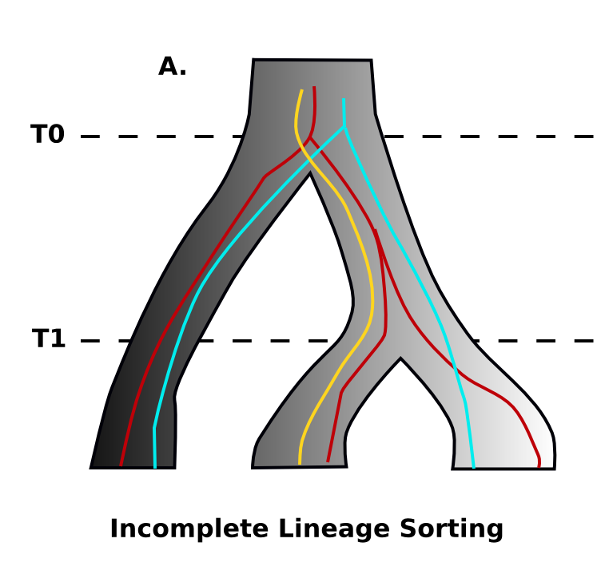
Uses of coalescent theory: Phylogenetics
Multispecies Coalescent: Extension to multiple species
Stochasticity in lineage sorting process (alleles randomly fixing in divergent populations) can cause variation in gene trees
Gene tree discordance makes inferring species trees difficult

Slide 35
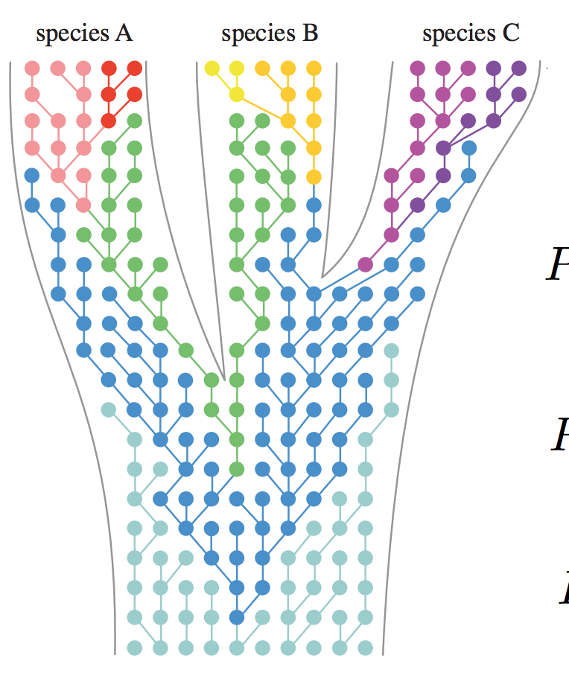
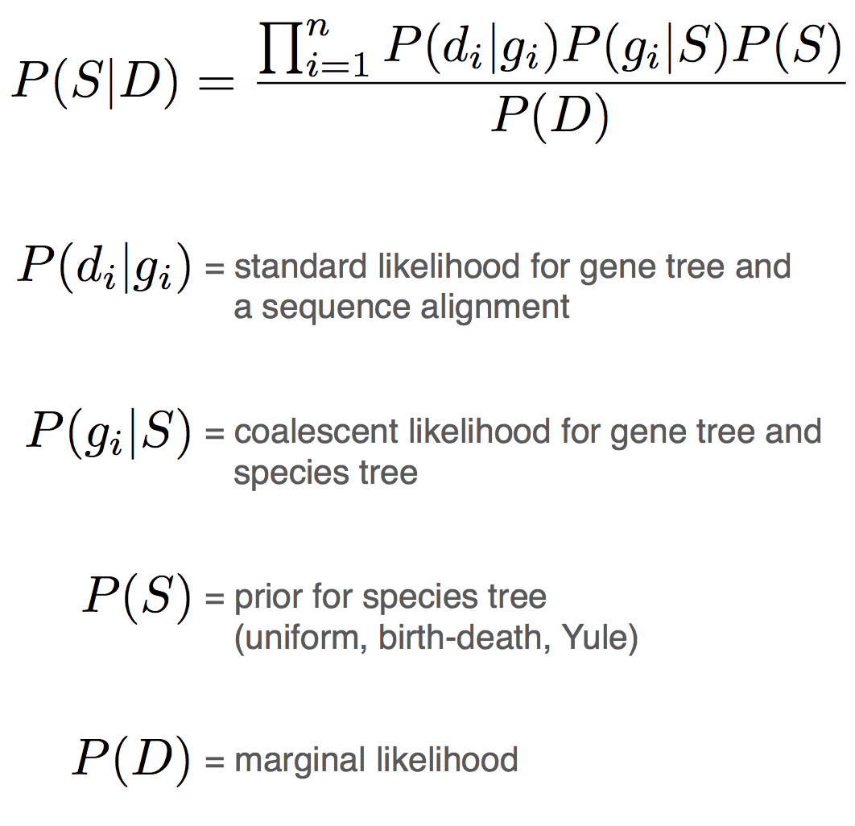
Uses of coalescent theory: Phylogenetics
Multispecies Coalescent: Extension to multiple species
Optimality criterion for phylogenetics using the MSC

Slide 36
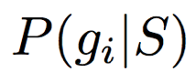
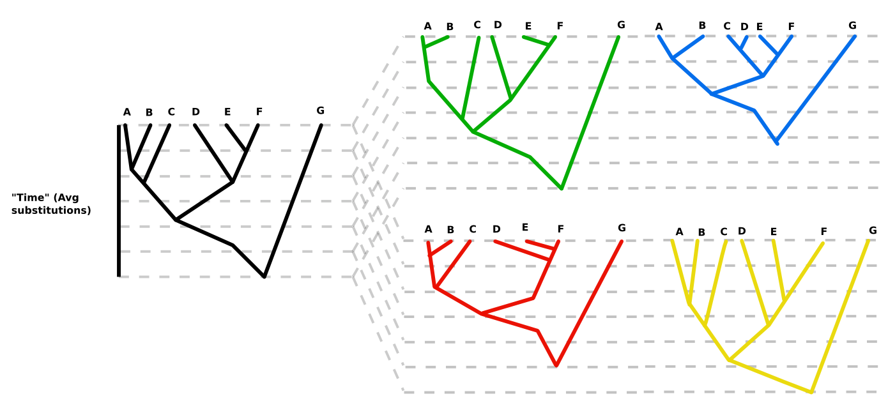
Uses of coalescent theory: Phylogenetics
Multispecies Coalescent: Extension to multiple species
Conceptually, this can be understood as comparing the expected distribution of gene trees for a given species tree, with the observed distribution (e.g. our data)
Species tree Gene trees

Slide 37
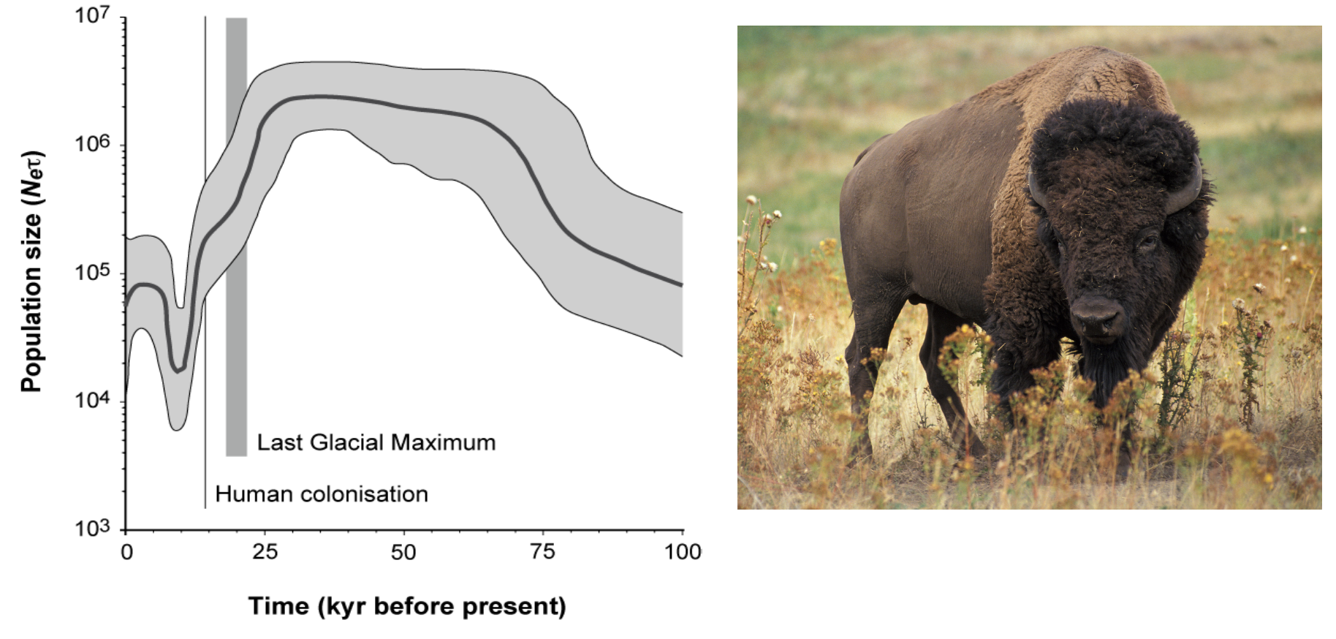
Today’s Dataset
mtDNA from Bison in North America
Image from Wil Freyman’s slides, Drummond et al (2005)

